Slide 1
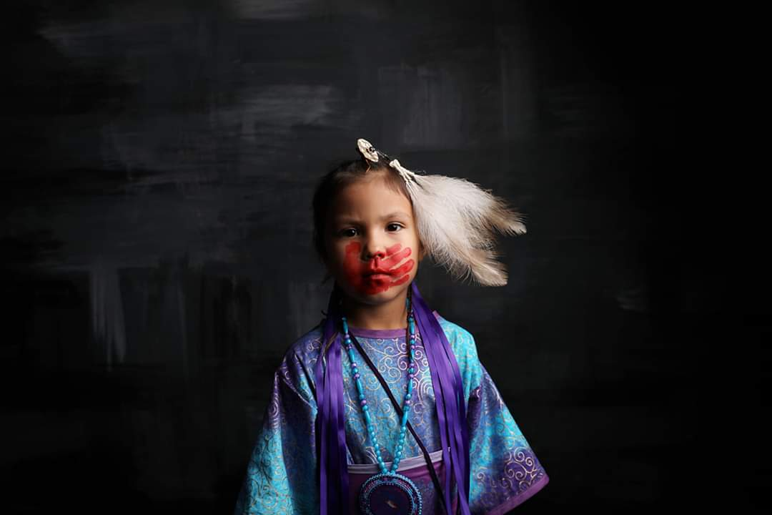

Slide 2
Exploring the American Indian Boarding School Experience
By 1926, nearly 83% of Indian school-age children were attending boarding schools.
357 boarding schools in 30 states
1900: 20,000 children in boarding schools
1925: 60,889 children in boarding schools
Retrieved online from : https//boardingschoolhealing.org/education/us-Indian-boarding-school-history/ on Tuesday, September 25, 2018 from the National Native American Boarding School Healing Coalition.

Slide 3
Clarence and Leona (Burr) Bowman
Jolene’s Maternal Grandparents
Jolene and Mom

Slide 4
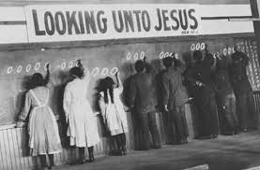
National Attitudes and Policies towards Indians
Mindset (1870-1900)
Controlling
Forcing Change
Stealing

Slide 5
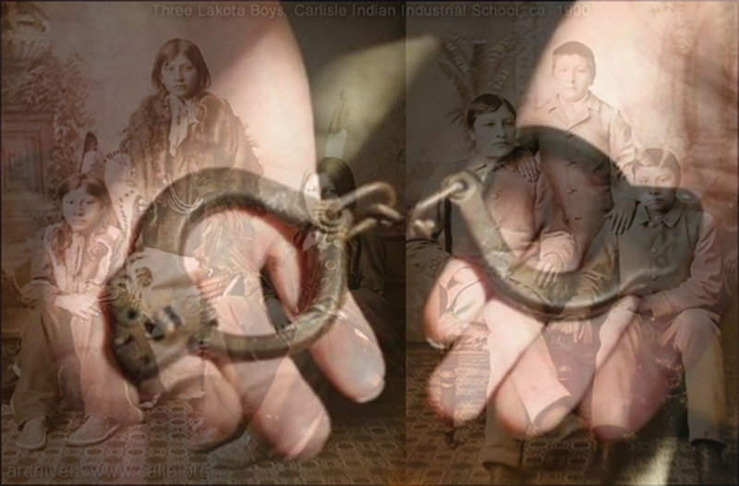
6
Retrieved online from : https//boardingschoolhealing.org/education/us-Indian-boarding-school-history/ on Thursday, March 29, 2018 from the National Native American Boarding School Healing Coalition.

Slide 6
Pause and Reflect
How do you think you would feel if this really happened to you, if you were?
Forbidden to speak the language from Earth and would have to learn the language that the aliens spoke;
Have to study the history and culture of the aliens; and
Have to practice the same religious beliefs, and ways of the aliens along with eating, dressing, and grooming just like the aliens.

Slide 7
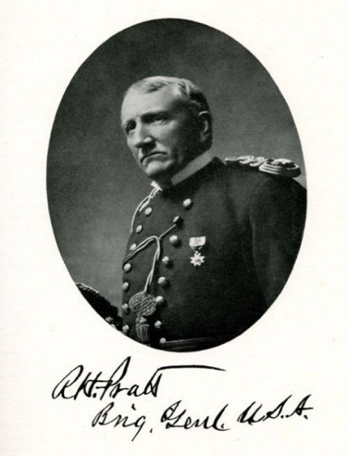
Historical Timeline
"A great general has said that the only good Indian is a dead one, and that high sanction of his destruction has been an enormous factor in promoting Indian massacres. In a sense, I agree with the sentiment, but only in this: that all the Indian there is in the race should be dead. Kill the Indian in him, and save the man."
— Gen. Richard Henry Pratt
1819 - Indian Civilization Act Fund of March 3, 1819
1855 - US Government makes provisions for Indian education in the 1855 Treaty
1866 - Indian landed ceded, Congress agrees to spend $25,000 for Indian Education
1869 - Peace Policy of 1869 the United States.
1875 - General Richard Pratt takes Apache POW’s to Florida for a social experiment.
1891 - Act of Congress established American Indian boarding schools
1928 – Meriam Report published outlining abuses, neglect, and failed educational practices in US boarding schools.
Retrieved online from: https//boardingschoolhealing.org/education/us-Indian-boarding-school-history/on Thursday, March 29, 2018 from the National Native American Boarding School Healing Coalition.

Slide 8
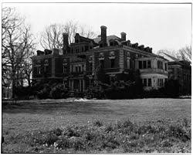

Slide 9
Pause and Reflect
Any thoughts or comments?
What was life like in the boarding schools?
What reactions did they have to this type of education?
What were some of the motives behind the movement to educate Indians in this manner?

Slide 10
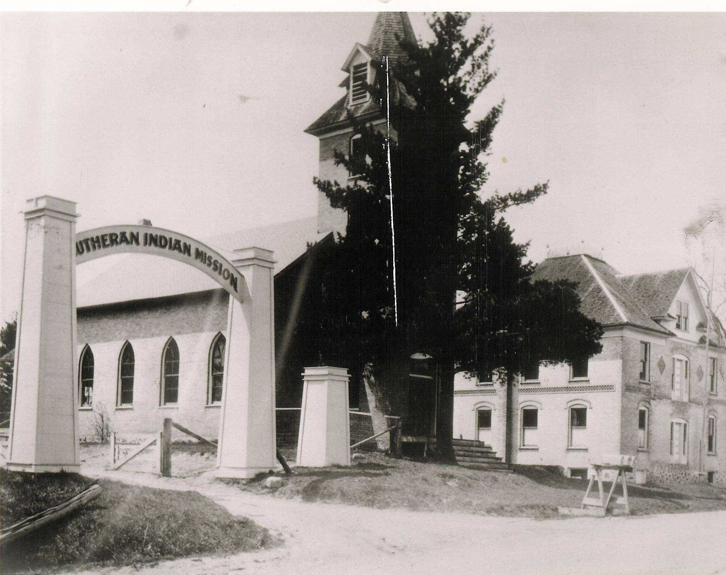
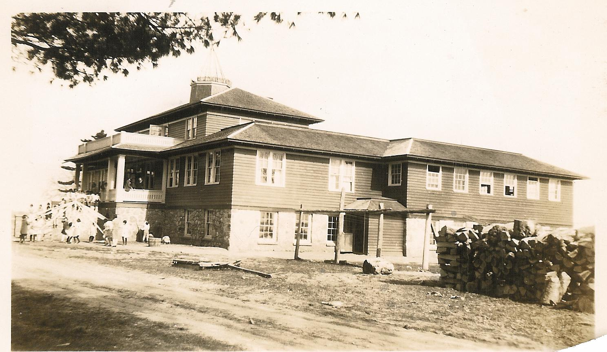
Education at the Lutheran Indian Mission in Red Springs, WI from 1901-1920

Slide 11
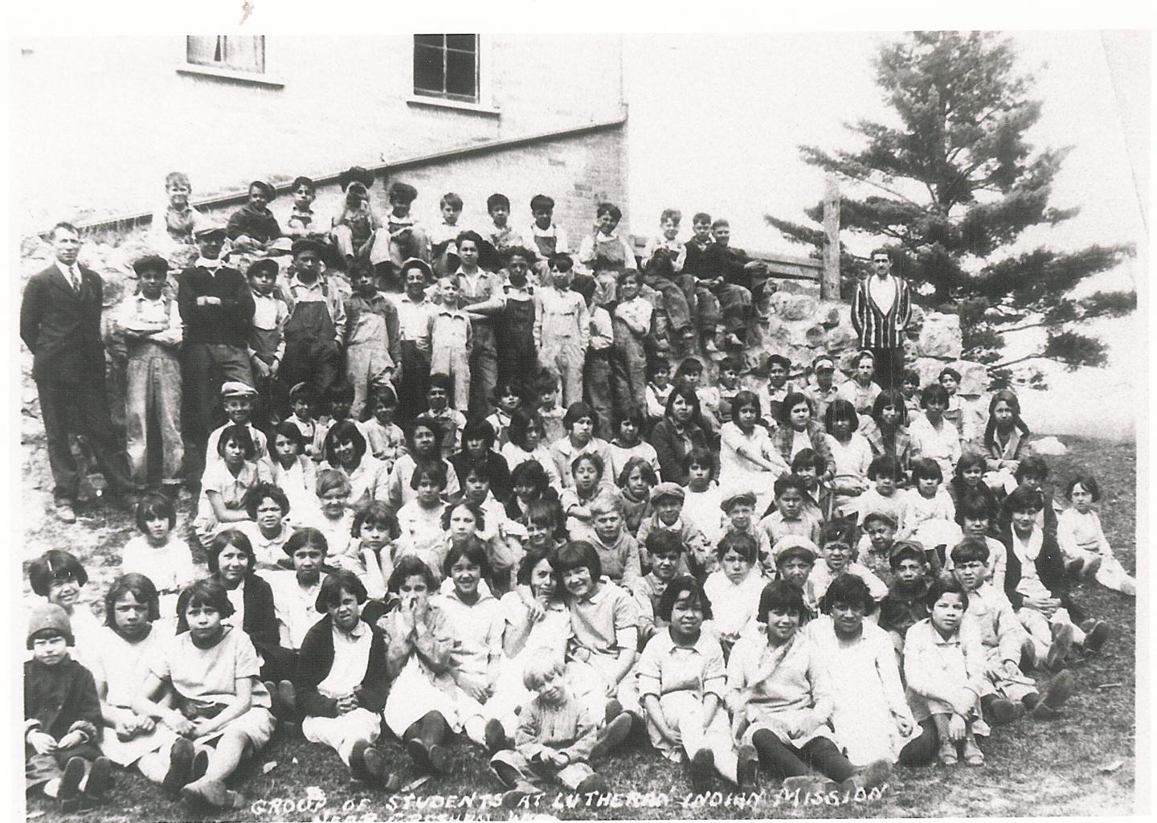
Staffing and Operation

Slide 12
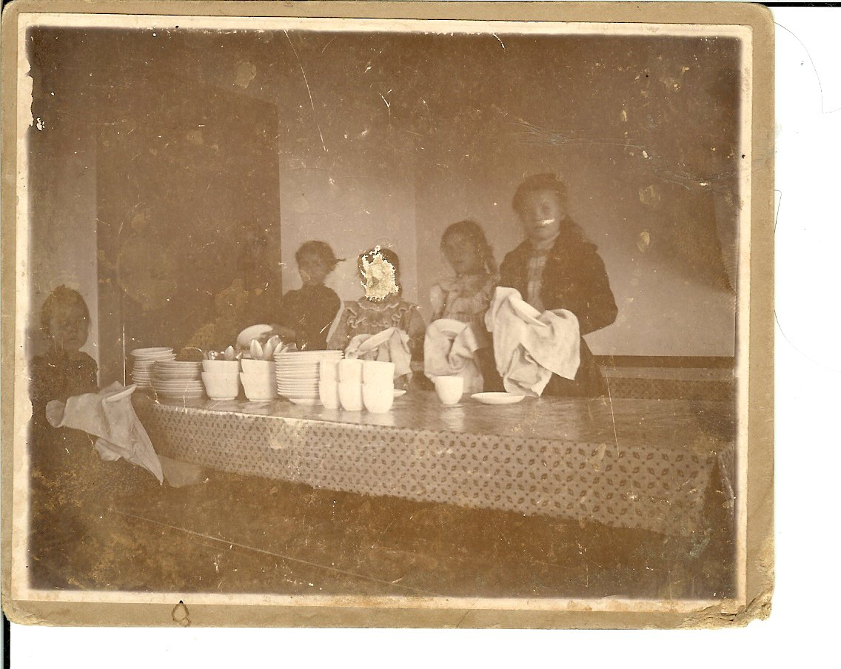
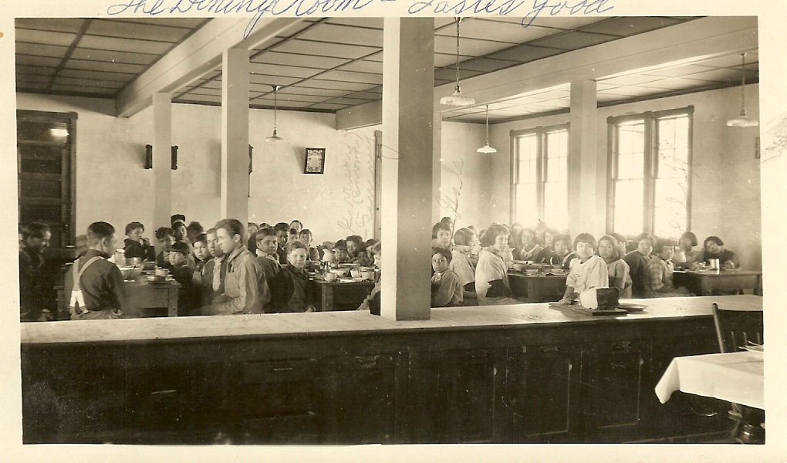
Roles and Responsibilities
Notes:
.

Slide 13
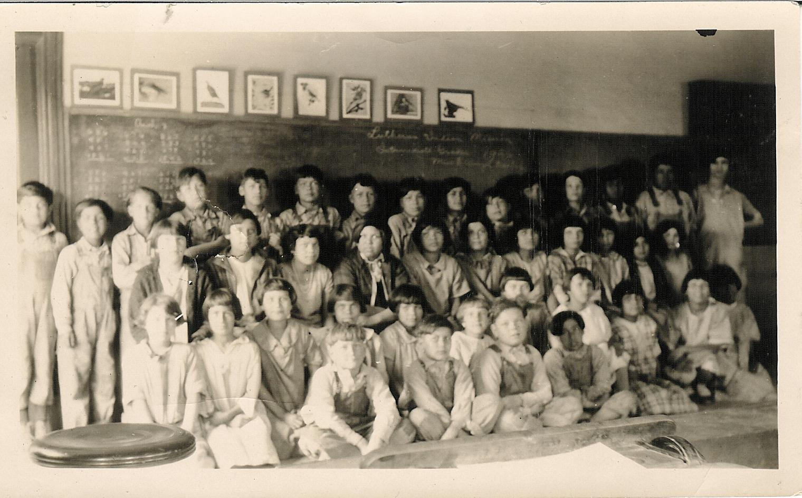
Schedule
Exercise Time

Slide 14
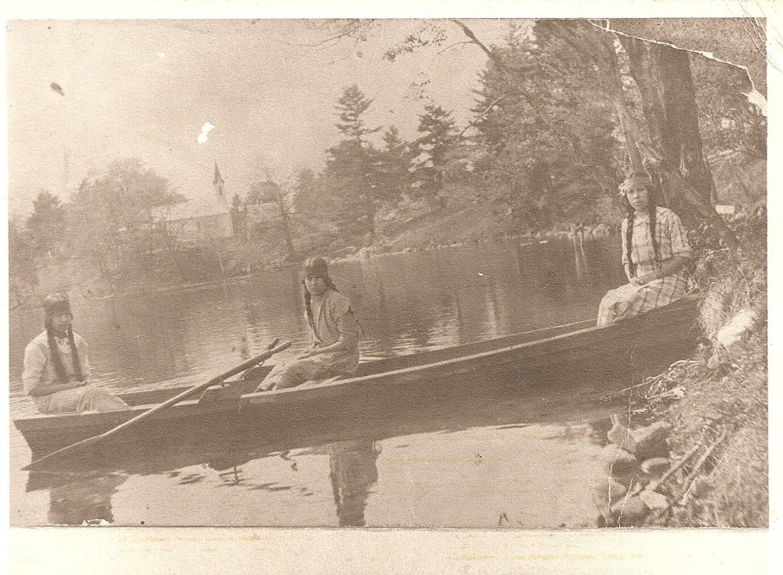
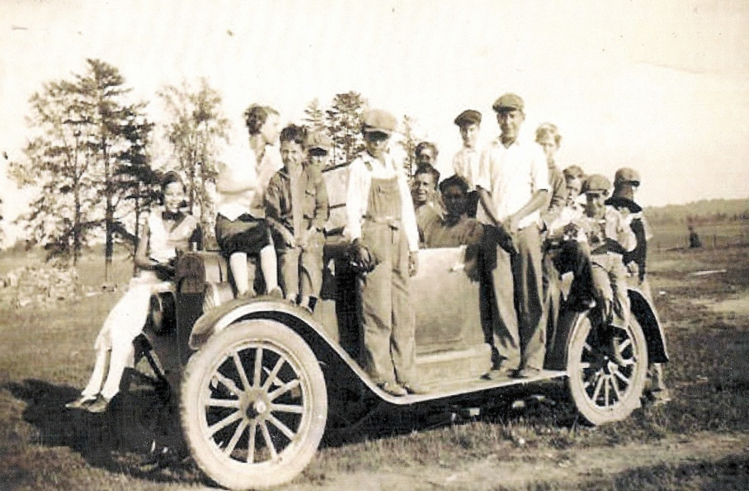
Leisure Time

Slide 15
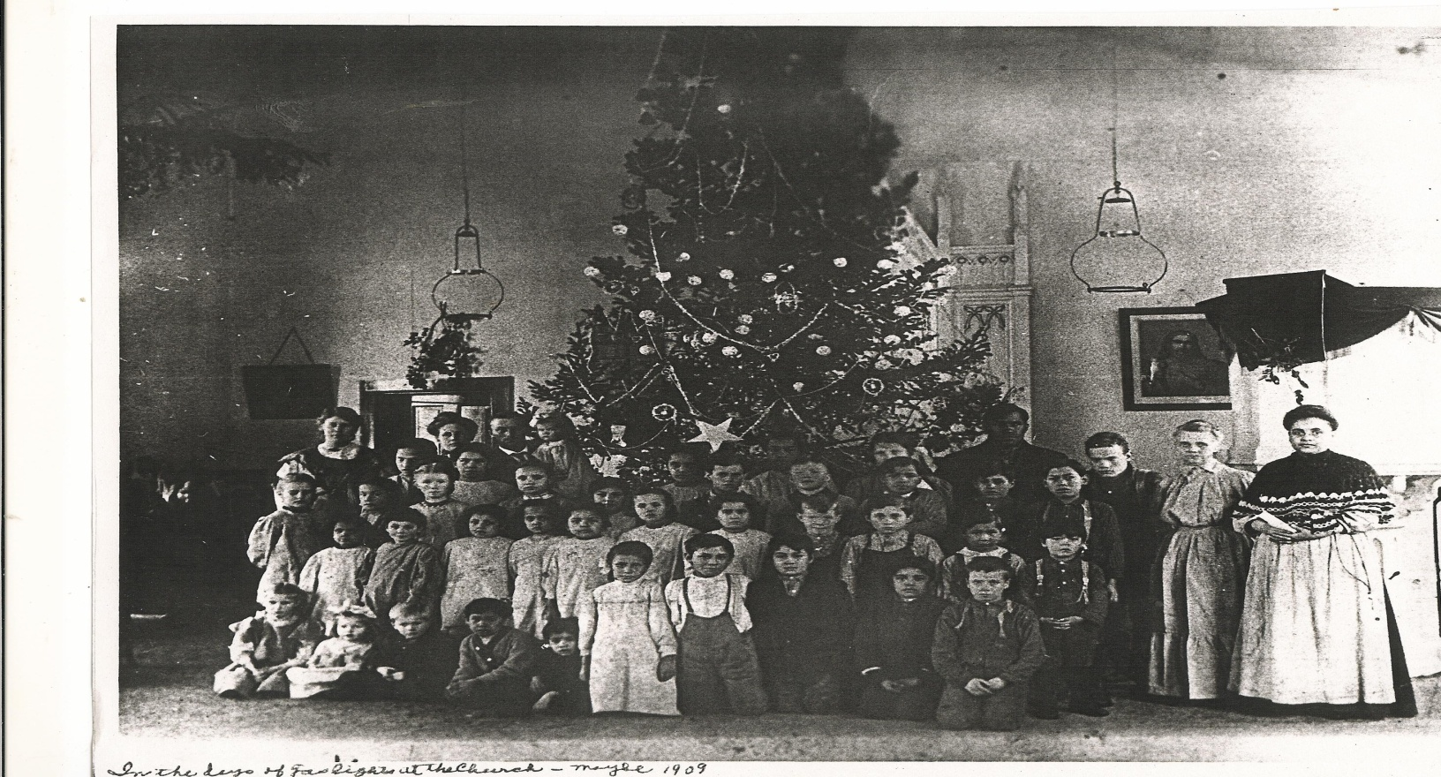
Holiday Time
Evening Time
Study Period
Bed time

Slide 16
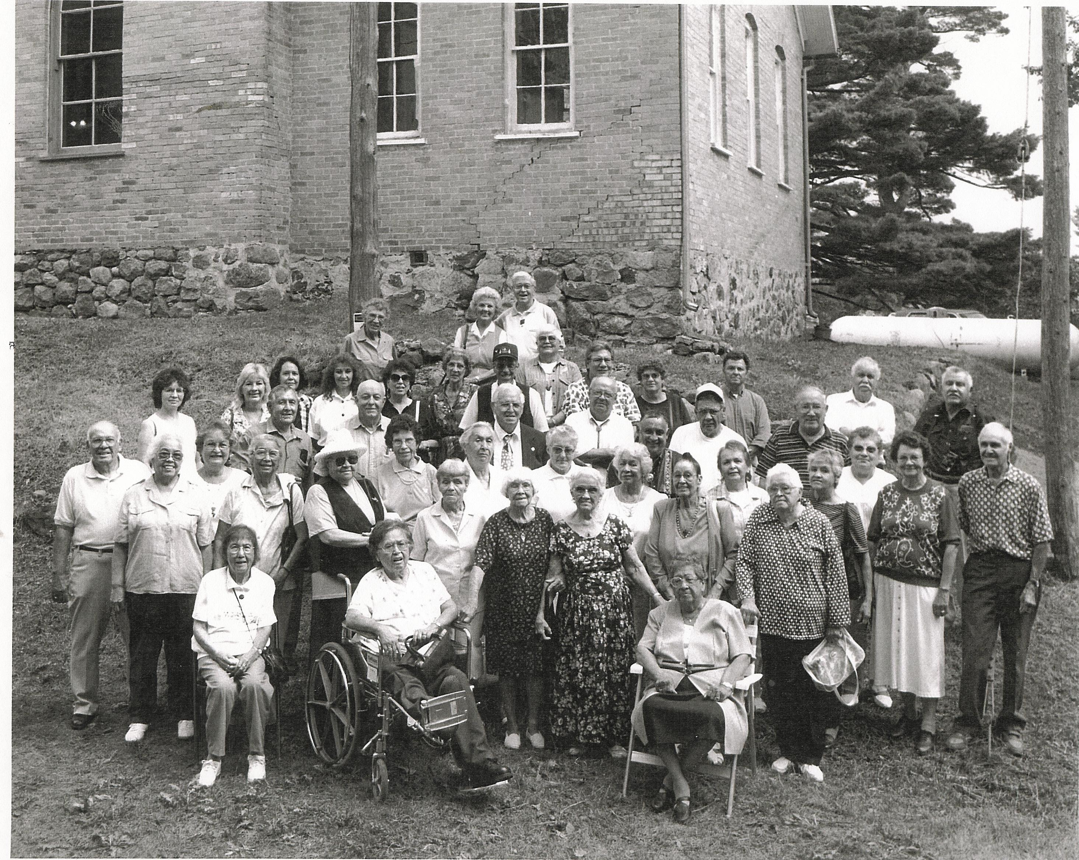

Slide 17
Oral history of discipline/abuse as told by our Elders
Rubbing salve near private parts
Kneeling on peas all day
Horse whipped with a stick called “cat of nine tails”
Throwing a cat into the furnace
Raising both hands high into the air
Sit under the teachers desk
Forced to be childcare providers
Standing against the wall

Slide 19
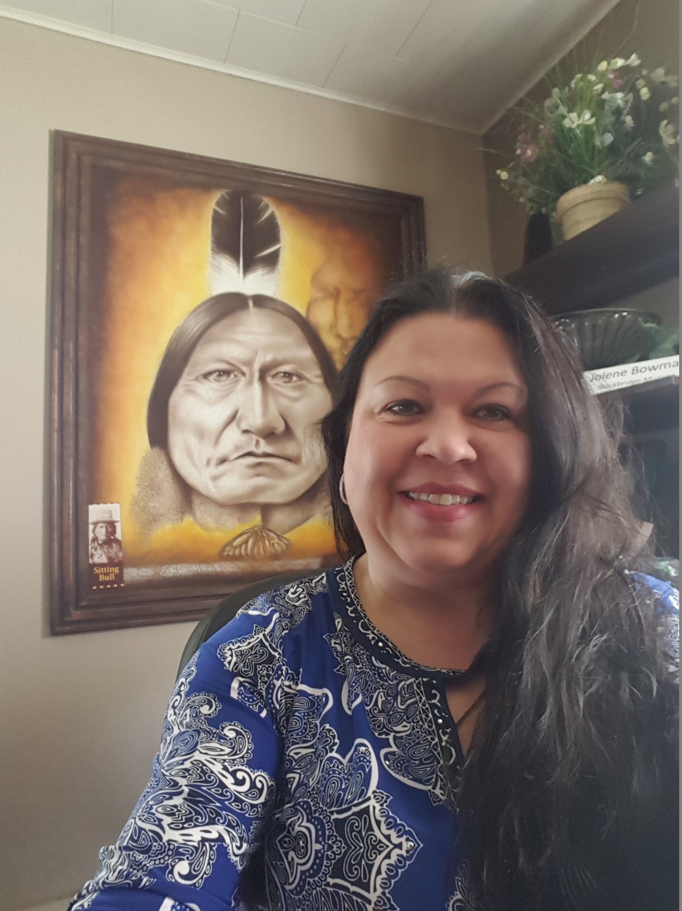
Thank You!
Jolene Bowman, Ph.D.
Director of Education and Career Services
Jolene.Bowman@Mohican-nsn.gov
Direct: 715-793-4060
Cell: 715-851-3734

